Slide 1


The Writing Process

Slide 2
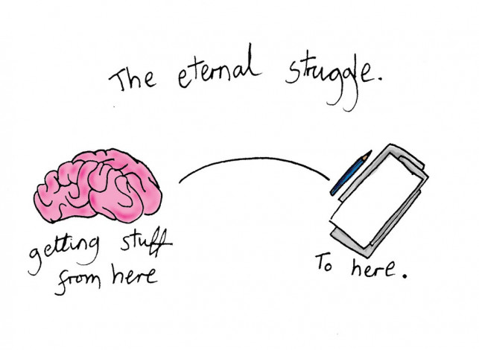
Writing is a complex process.
Notes:
Writing is a vehicle for communication and skill required in all aspects of life.

Slide 3
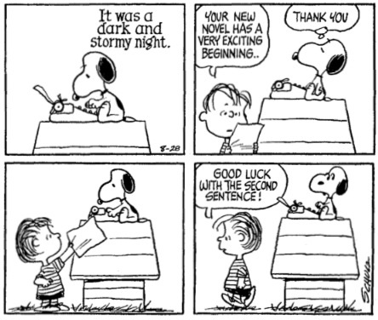

Slide 4

Steps of the Writing Process
Prewriting
What to write about?
Collecting ideas
Research
Draft
1st document
Revising
Review and assess
Editing
Proofreading
Writing is a developmental process.

Slide 5
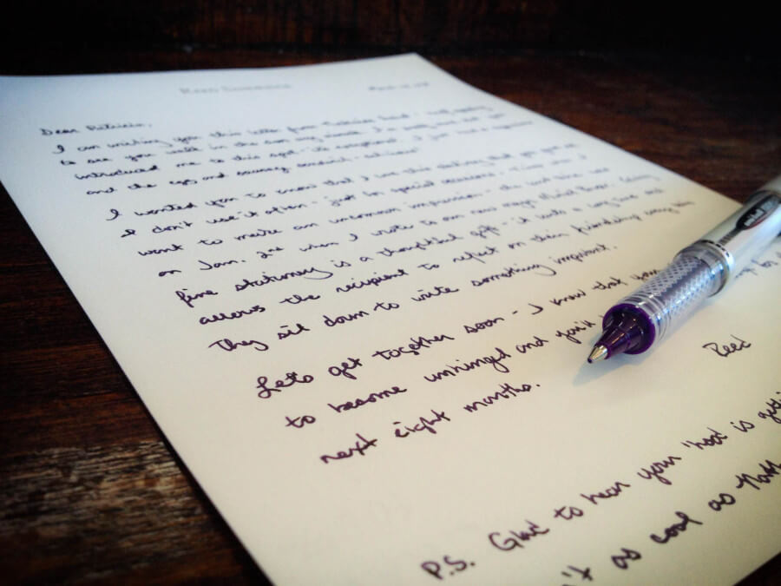
Prewriting
Writing is not easy
Mental blocks may occur
Time management issue
Unable to come up with a topic
Allows writers to discover
What do I know about?
Which ideas should be included?
Make decisions
Different aspects of writing

Slide 6



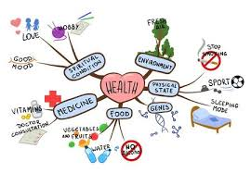

5 Prewriting Techniques
Freewriting
Questioning
Making Lists
Clustering
Scratch Outline
Thinking on paper
What to write about?
Listing ideas
Connecting related ideas
Organizing ideas

Slide 7

Freewriting

Slide 8

Jotting down all the ideas
Sentences or phrases
Write non-stop for 5-10 minutes
Mistakes do not matter
Spelling
Grammar
Punctuations
Explore ideas
Even if they are not connected
Write all the ideas
Advantages of freewriting
Getting over mental block
Focus on the subject
Thinking on paper

Slide 9

Questioning

Slide 10

Come up with more ideas about your topic
Generate details
Location
Personality
Process
Ask as many questions as you can
Effective way of
Looking at a topic from different angles

Slide 11

Making a List

Slide 12




Making Lists
Brainstorm
Collect Details
Research
Thinking of ideas/details
Do not sort the details
Use different resources for collecting ideas/facts
What to do now that you have a topic in mind?

Slide 13
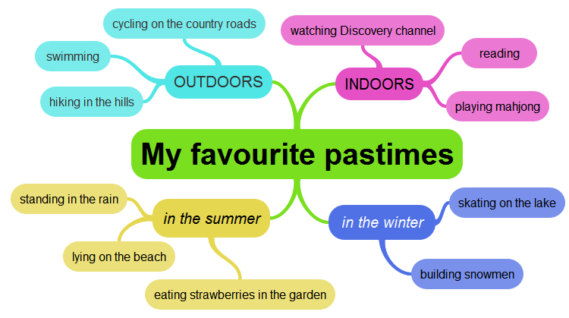
Clustering / Mind Maps
Notes:
Technique useful for visual learners
You can use images/ diagrams

Slide 14
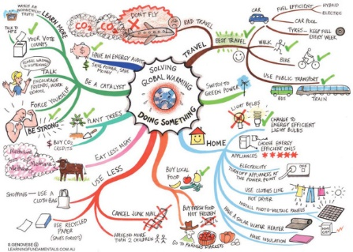

Slide 15

Creating a Scratch Outline

Slide 16
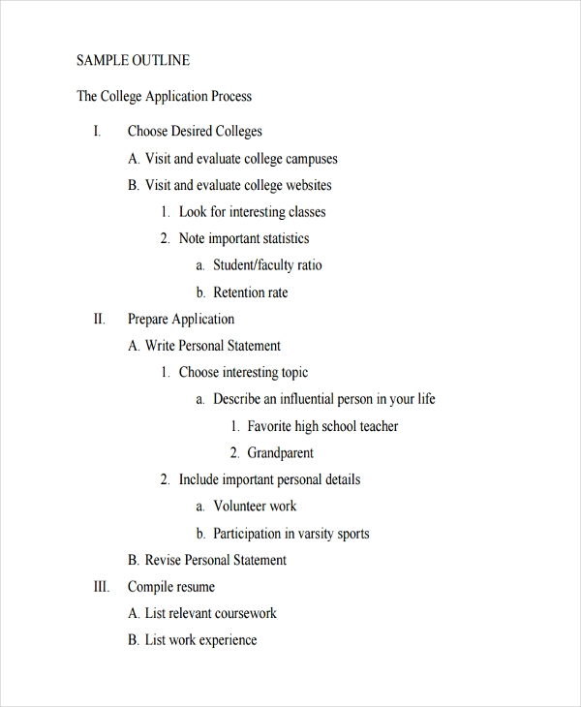
Outline follows the first four techniques
Material organization
Review if more materials are required
Think about your perspective on the topic
Categorize information collected
Identify the main points
Classify the sub points
If you do not have enough material
Go back to the prewriting step
Organize information
Changes can be made

Slide 17

Writing your First Draft

Slide 18

Develop your first draft
Be flexible
Make additions where needed
Focus on
Content development
Write details
Mistakes can be corrected
Make notes where needed
Will help you make additions/deletions where needed

Slide 19
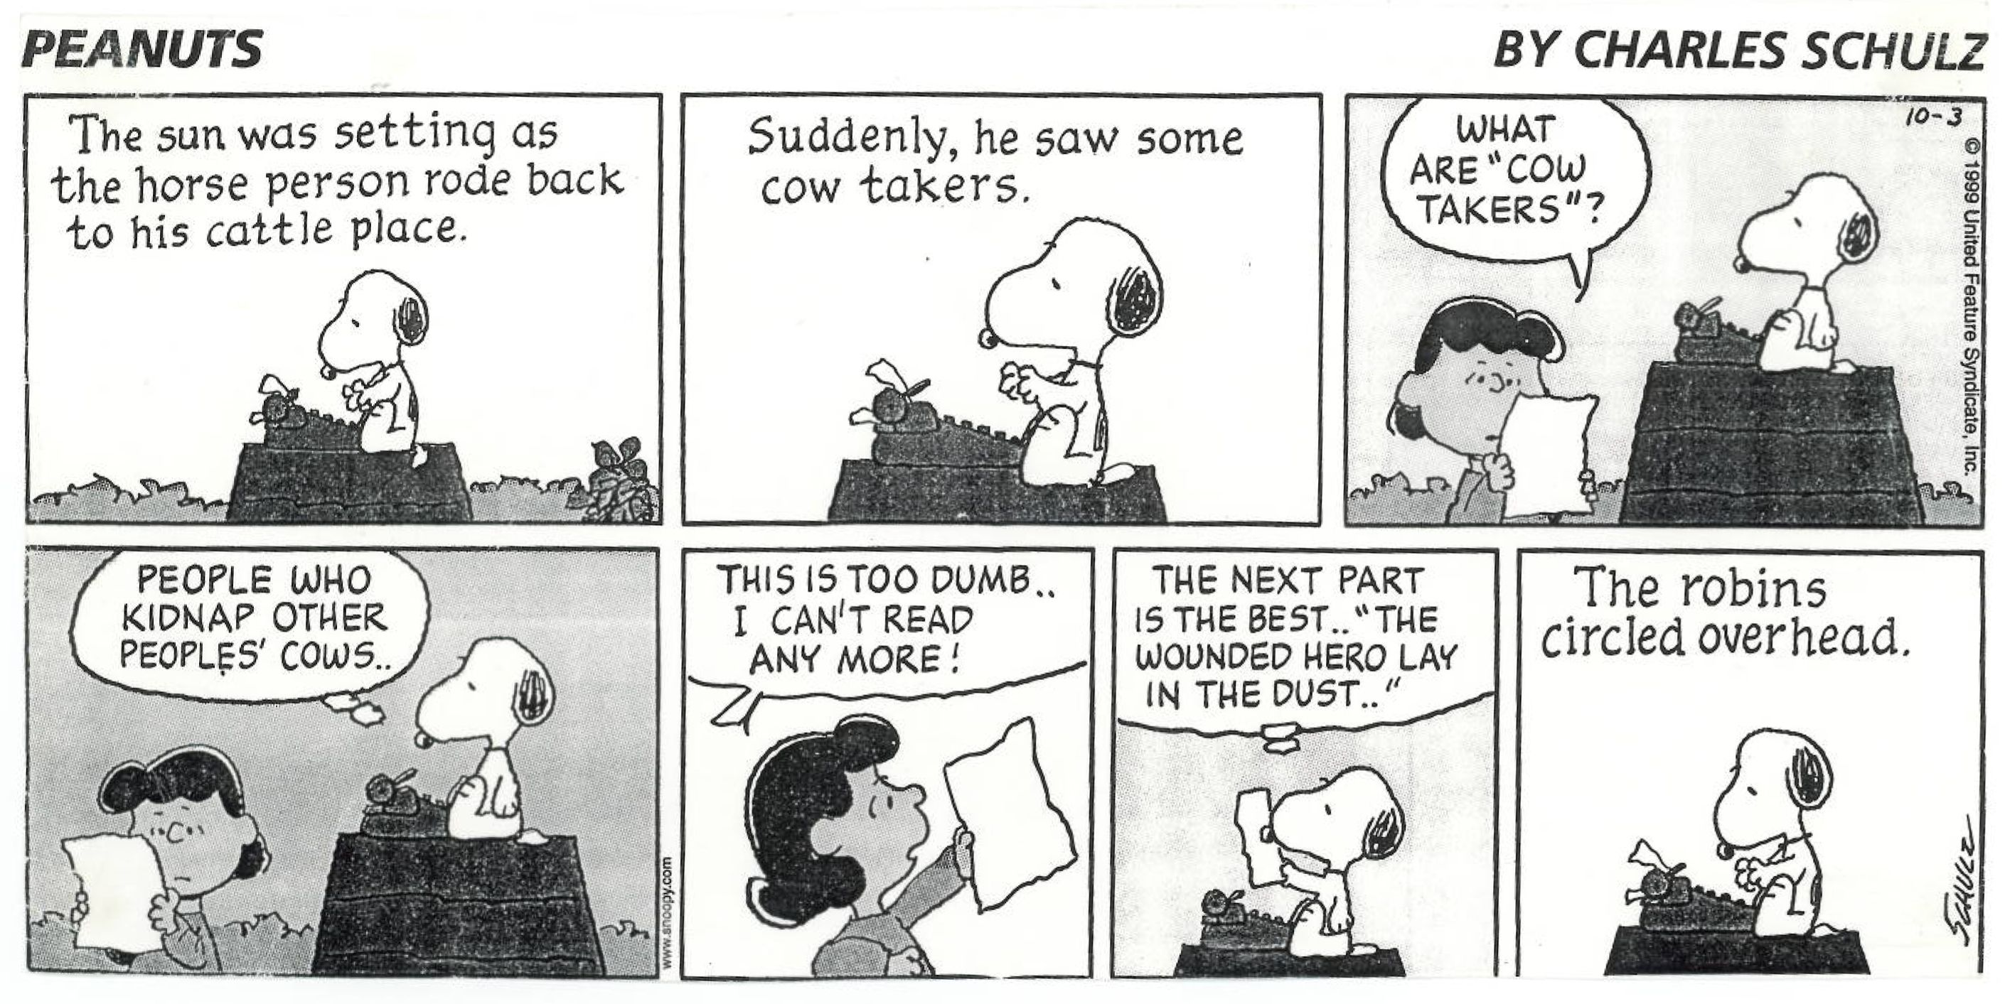

Slide 20

Revising
Revising Sentences
Revising Content
Editing

Slide 21

Revising Content
Is my writing (essay/paragraph) unified?
Do I have one opinion/argument?
Do the supporting details, support the main argument provided?
In my writing supported?
Do I have specific evidence for the supporting ideas?
Is my writing organized
Is the introduction interesting?
Have a provided a well written conclusion?
Is the title appropriate?

Slide 22

Revising Sentences
Do I have a consistent point of view?
Do I use specific words?
Do I use active verbs?
Do I use words effectively by avoiding slang, clichés, pretentious language, and wordiness?
Do I vary my sentences?

Slide 23
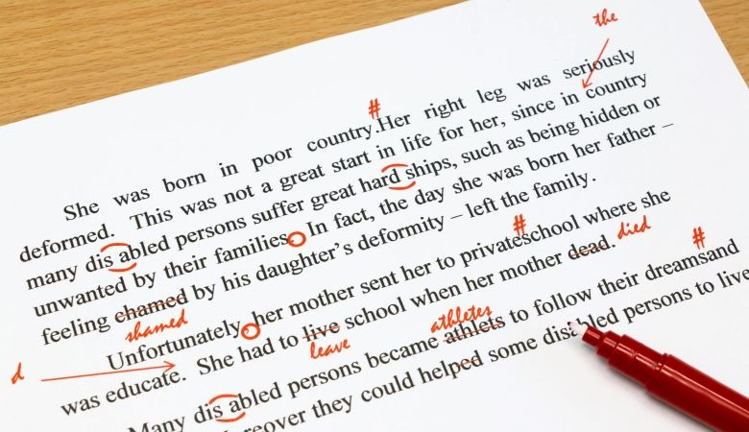
Editing & Proofreading

Slide 24
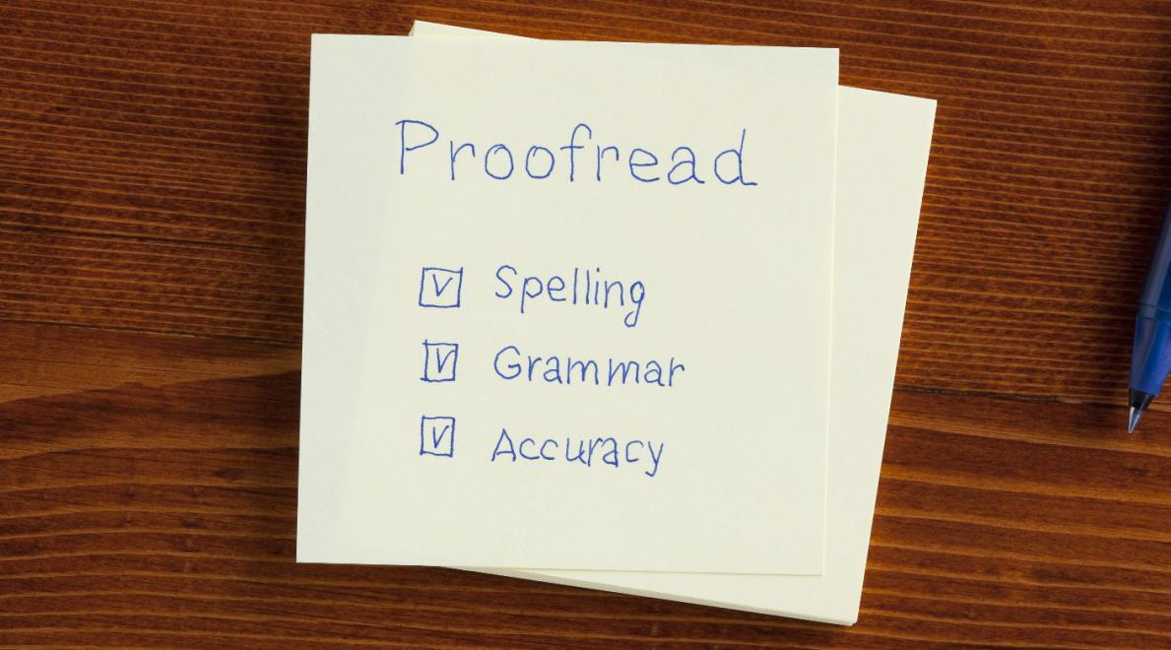

Slide 25
